Slide 1
Unit 1
The Software Development Life Cycle

Slide 2
SDLC
Pre-development phases of the SDLC –
Development specific phases of the SDLC –
Post-development phases of the SDLC;

Slide 3
SDLC
The goals of this SDLC approach are to:
  Deliver quality systems which meet or exceed customer expectations when promised and within cost estimates.
  Provide a framework for developing quality systems using an identifiable, measurable, and repeatable process.
  Establish a project management structure to ensure that each system development project is effectively managed throughout its life cycle.
  Identify and assign the roles and responsibilities of all involved parties, including functional and technical managers, throughout the system development life cycle.
  Ensure that system development requirements are well defined and subsequently satisfied.

Slide 4
Pre-development phases of the SDLC
A process was defined as a collection of work activities, actions, and tasks that are performed when some work product is to be created.
Each of these activities, actions, and tasks resides within a framework or model that defines their relationship with the process and with one another.

Slide 5
Pre-development phases of the SDLC
A generic process framework for software engineering defines five framework activities—
  communication,
  planning,
  modeling,
  construction,
  and deployment .

Slide 6
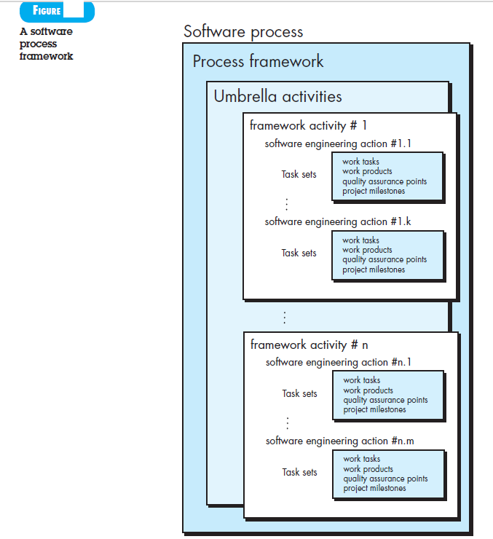
Pre-development phases of the SDLC

Slide 7
Pre-development phases of the SDLC
Software process - Collection of work activities, actions, and tasks to create work products.
Framework - Activities, actions, and tasks reside with relationship.
Framework activities - communication, planning, modeling, construction, and deployment
Umbrella activities - project tracking and control, risk management, quality assurance, etc.

Slide 8
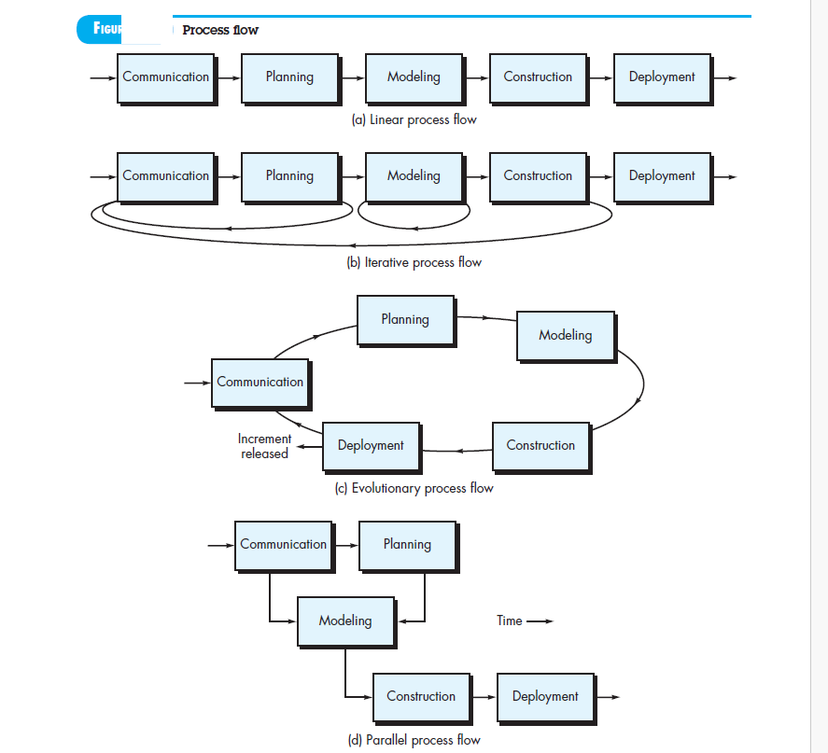
Pre-development phases of the SDLC

Slide 9
Pre-development phases of the SDLC
Communication : In an SDLC, this is the first and most crucial phase for a software project's success. In this phase, communication takes place between stakeholders, end-users, and project teams, as both functional and non-functional requirements are gathered from customers.

Slide 10
Pre-development phases of the SDLC
Planning : Planning helps systems engineers and developers identify whether a new system can help a business achieve its strategic objectives.
A preliminary plan, sometimes called a feasibility study, can allow development teams to outline the resources they need to build new infrastructure or upgrade existing services.
This life cycle phase helps teams discover potential problems and work toward solutions.

Slide 11
Pre-development phases of the SDLC
Modeling :
SRS is the reference for product architects to come out with the best architecture for the product to be developed.
Based on the requirements specified in SRS, usually more than one design approach for the product architecture is proposed and documented in a DDS - Design Document Specification.
This DDS is reviewed by all the important stakeholders and based on various parameters as risk assessment, product robustness, design modularity, budget and time constraints, the best design approach is selected for the product.

Slide 12
Pre-development phases of the SDLC
Construction :
In this stage of SDLC the actual development starts and the product is built.
The programming code is generated as per DDS during this stage. If the design is performed in a detailed and organized manner, code generation can be accomplished without much hassle.
Developers must follow the coding guidelines defined by their organization and programming tools like compilers, interpreters, debuggers, etc. are used to generate the code.
Different high level programming languages such as C, C++, Pascal, Java and PHP are used for coding.
The programming language is chosen with respect to the type of software being developed.

Slide 13
Pre-development phases of the SDLC
Deployment :
In this stage of work, the software is deployed into a production environment.
The work gathered, designed, developed, and tested is shared with the consumers and users of the software service.
This process involves provisioning infrastructure within an on-premise or cloud provider and defining a software deployment strategy for delivering the changes to a customer.

Slide 14
Development specific phases of the SDLC
Each software process models has generic framework activities but a order of activities, actions and task.
PRESCRIPTIVE PROCESS MODELS
  1 Waterfall Model
  2 Incremental Process Models
  3 Evolutionary Process Models : prototyping, spiral.
  4 Concurrent model

Slide 15
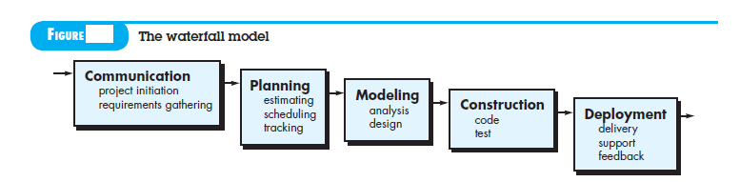
Waterfall Model
The waterfall model, the classic life cycle- a systematic, sequential approach to software development.
Progresses through planning, modeling, construction, and deployment.
Workflow from communication through deployment.

Slide 16
Waterfall Model
When to use this model ?
  1. software requirements are reasonably well dened, no technology issues, small project, no customer interaction in between
  2 Work is to proceed to completion in a linear manner.
  Example : website for shopping mall
Problem :
  Sequential flow, Natural uncertainty, Late working version, Delay in Dependency task, Exceed production time.

Slide 17
Incremental process model
Combines activity of linear and parallel process flows.
The first increment is often a core product.
Supplementary features are added up.
Focuses on the delivery of an operational product with each increment.
When to use this model ?
  1 Limited set of software functionality.
  2 Refine and expand on that functionality in later software releases, lengthy developments schedules, Projects with new Technology.

Slide 18
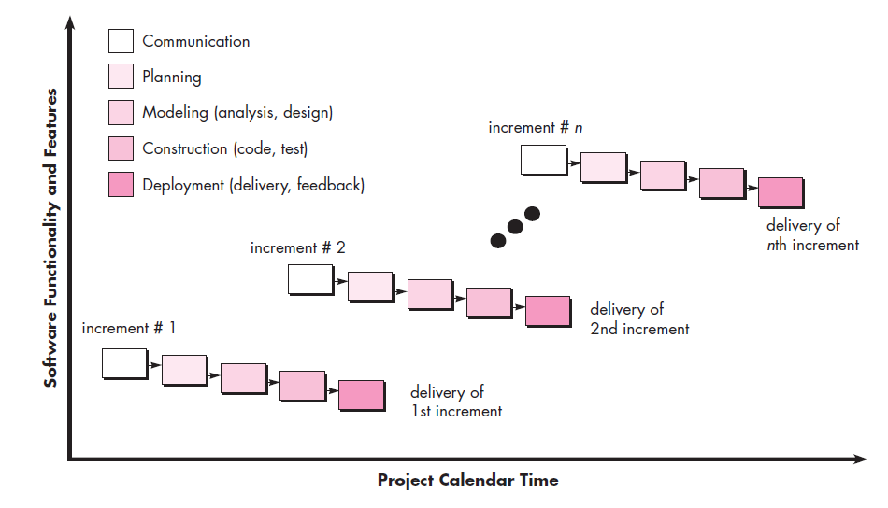
Incremental process model

Slide 19
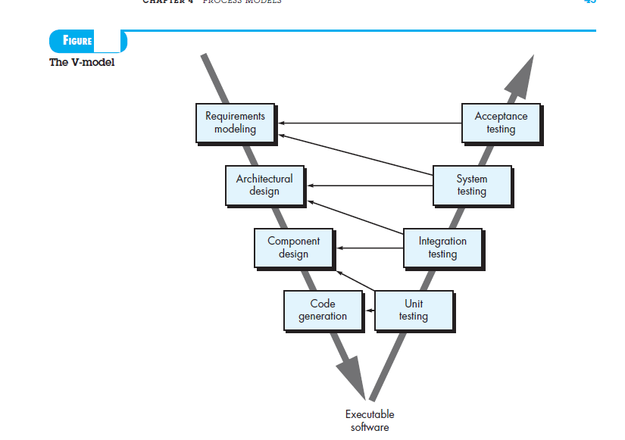
V model

Slide 20
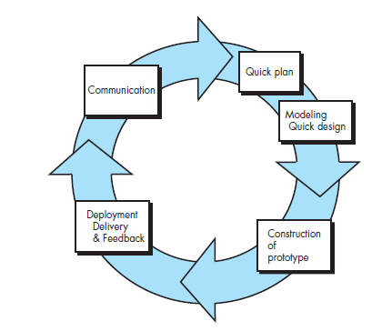
Evolutionary Process Models
Prototype:
  The prototype can serve as the rst system and mechanism for identifying software requirements.
  Quick design focuses on aspects visible to end users. Quick design leads to the construction of a prototype.
  Working programs generated quickly
  The prototype is deployed and evaluated by stakeholders,

Slide 21
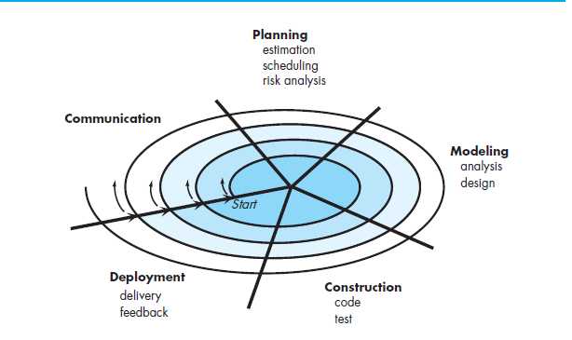
Evolutionary Process Models
Spiral :
Adapted to apply throughout the life of the software.
Combines linear and iterative process model Software is developed in a series of evolutionary releases and will evolve through a number of iterations around the spiral.
Subsequent passes around the spiral might be used to develop a prototype and then progressively more sophisticated versions of the software.
Technical risk is considered as each revolution is made.

Slide 22
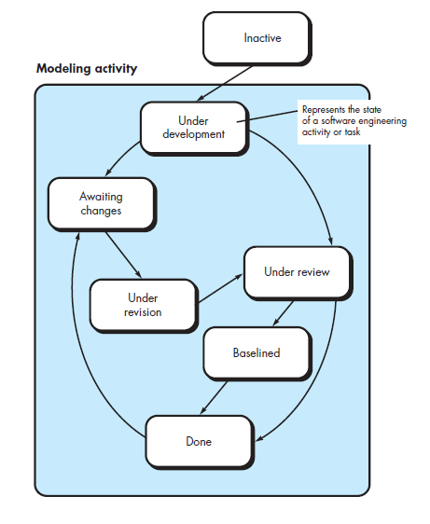
Concurrent Models
Applicable to all types of software development and provides an accurate picture of the current state of a project.
Defines a series of events that will trigger transitions from
state to state for each of the software engineering activities, actions, or tasks.
Independently built independent pieces, improved resource utilization, early finish.

Slide 23
SPECIALIZED PROCESS MODELS
1. Component-Based Development
  Commercial o-the-shelf (COTS) software components
  Works towards targeted functionality
  Supports well defined interfaces
  Many components can be integrated into the software
  Modeling and construction activities begin with the identication of candidate components.

Slide 24
SPECIALIZED PROCESS MODELS
Formal Methods Model
Formal mathematical specification
Specify, develop, and verify using mathematical notation
Cleanroom software engineering
Application of mathematical analysis
Program verication - discover and correct errors

Slide 25
Post-development phases of the SDLC
Operations and Maintenance
  The system operation is ongoing.
  The system is monitored for continued performance in accordance with user requirements and needed system modifications are incorporated.
  Operations continue as long as the system responds to the organization’s needs.
  When modifications are identified, the system may reenter the planning phase.
  In the context of the SDLC, deployment of the software, when it's in use and maintenance is done.
  This could involve updates, bug fixes, and other adjustments to ensure the software continues to function as intended.

Slide 26
Summary
Pre-development phases of the SDLC –
Development specific phases of the SDLC –
Post-development phases of the SDLC;

